Slide 1
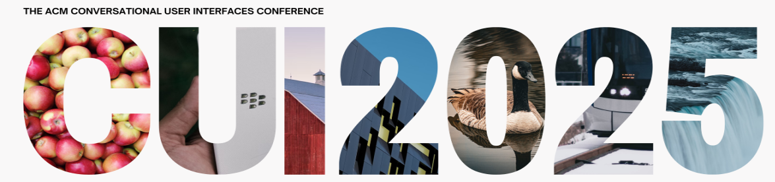




Mitigating Response Delays in
Free-Form Conversations with
LLM-powered Intelligent Virtual Agents
Mykola Maslych, Mohammadreza Katebi, Christopher Lee,
Yahya Hmaiti, Amirpouya Ghasemaghaei, Christian Pumarada,
Janneese Palmer, Esteban Segarra Martinez, Marco Emporio,
Warren Snipes, Ryan P. McMahan, Joseph J. LaViola Jr.

Slide 2
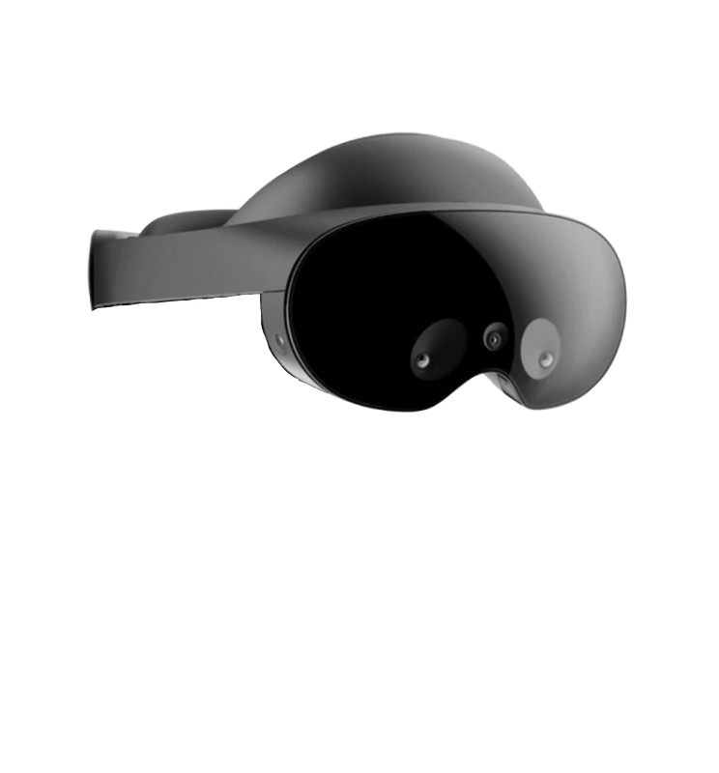
Computation cost and network-related latency
ASR
LLM
TTS

Slide 3
Computation cost and network-related latency
ASR
LLM
TTS

Slide 4
Background
Prior studies
  Video analysis
  Wizard of Oz
  Predetermined Q-A pairs
This study
  Free-form
  Responses generated in real-time
  Varied latency and fillers during wait time

Slide 5
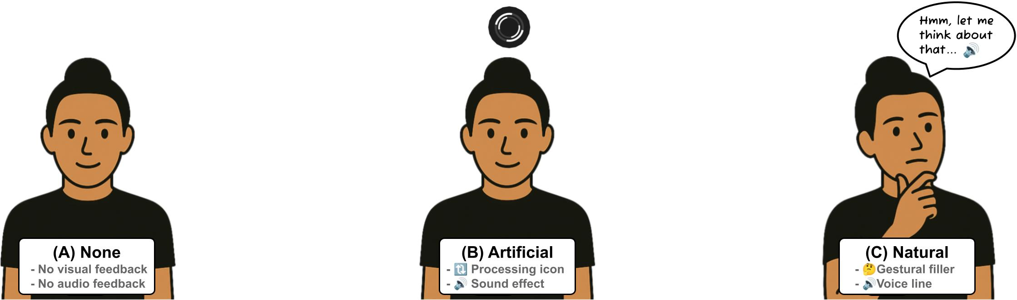
Study Design: Free-form conversations with IVAs
Effects of response latency on
  Perceived time until response
  Broader perception dimensions
Can conversational fillers mitigate this delay?
  Artificial fillers (🔃processing icon + 🔊sound effect)
  Natural fillers (🤔thinking gesture + 🔊voice line)

Slide 6
Study Design: Conditions [3 X 3]

Slide 7
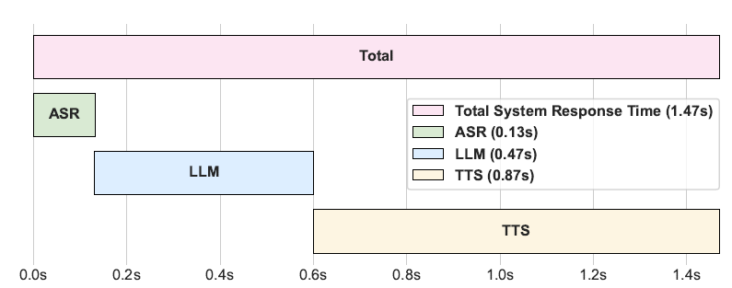
Study Design: Conditions [3 X 3]
Delay Levels
Low (1.5s)
Filler types

Slide 8
Study Design: Conditions [3 X 3]
Delay Levels
+2.5s
Low (1.5s)
Medium (4s)
Filler types

Slide 9
Study Design: Conditions [3 X 3]
Delay Levels
+2.5s
+5s
Low (1.5s)
Medium (4s)
High (6.5s)
Filler types

Slide 10
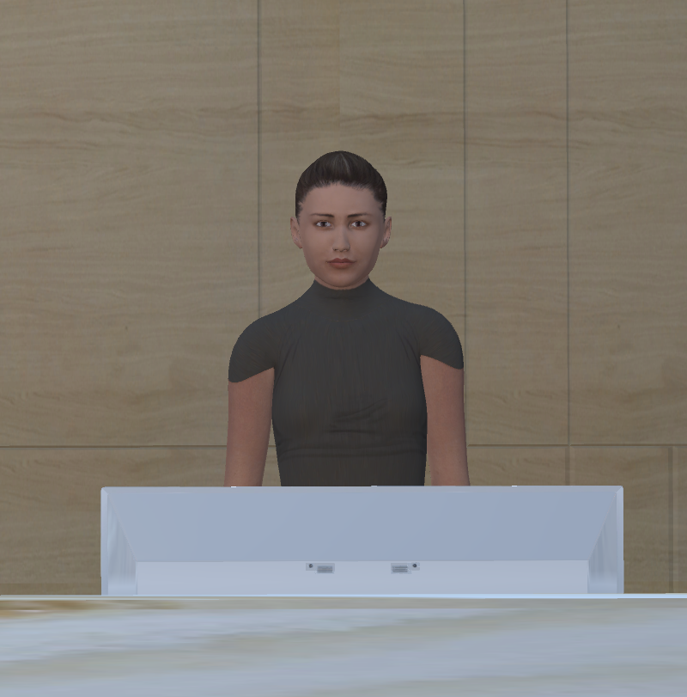
Study Design: Conditions [3 X 3]
Delay Levels
+2.5s
+5s
Low (1.5s)
Medium (4s)
High (6.5s)
Filler types
None

Slide 11
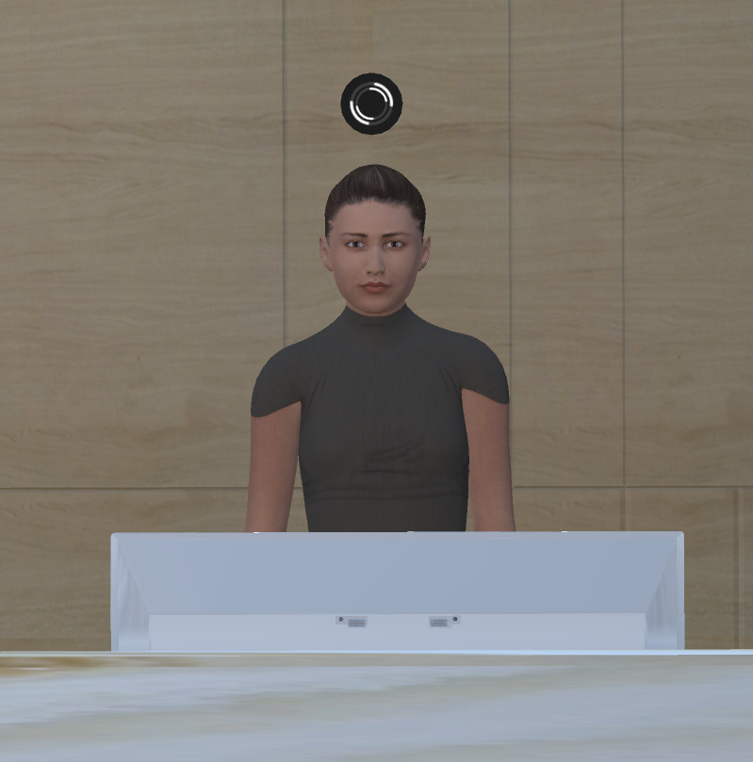
Study Design: Conditions [3 X 3]
Delay Levels
+2.5s
+5s
Low (1.5s)
Medium (4s)
High (6.5s)
Filler types
None
Artificial

Slide 12
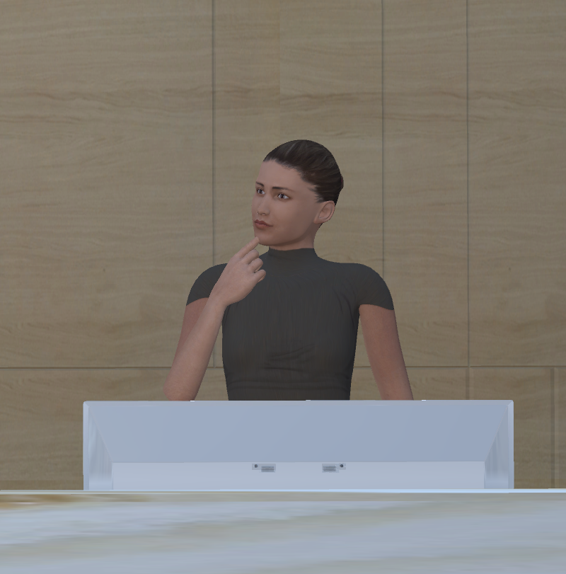
Study Design: Conditions [3 X 3]
Delay Levels
+2.5s
+5s
Low (1.5s)
Medium (4s)
High (6.5s)
Filler types
None
Artificial
Natural

Slide 13
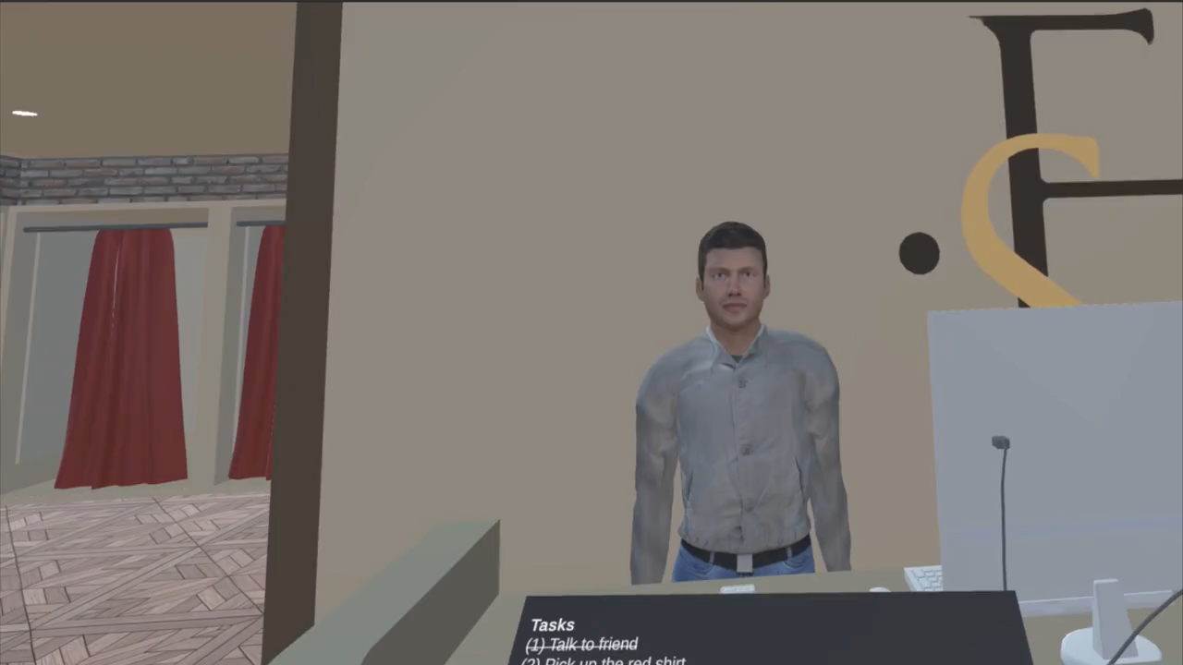
Example conversational turns
Latency: Medium (4.0 sec)
Fillers: None, Artificial, Natural

Slide 14
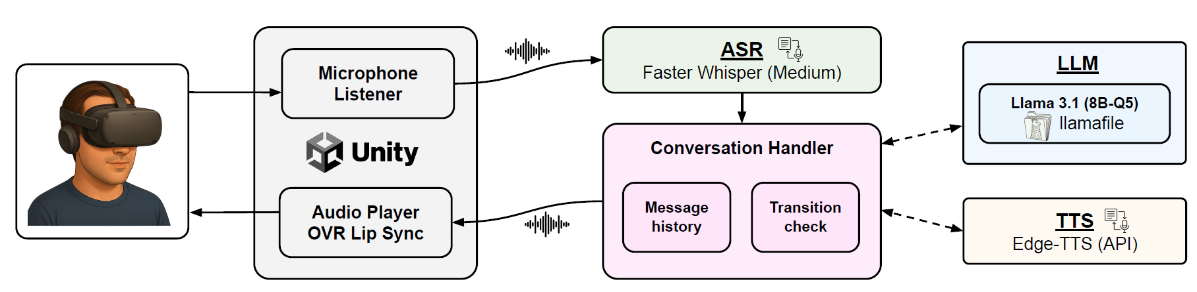
Conversations with Intelligent Virtual Agents
Free-form speech, guided by high-level tasks
Each agents’ role defined in their LLM prompt

Slide 15
User Study Procedure
→ Participation consent
→ Demographics survey
Onboarding
VR portion
Post-study survey
→ Converse with an agent
→ Answer post-condition survey
→ Advance to next agent
x9
→ Overall experience questions
→ Explanation of study conditions
→ Questions about study conditions

Slide 16
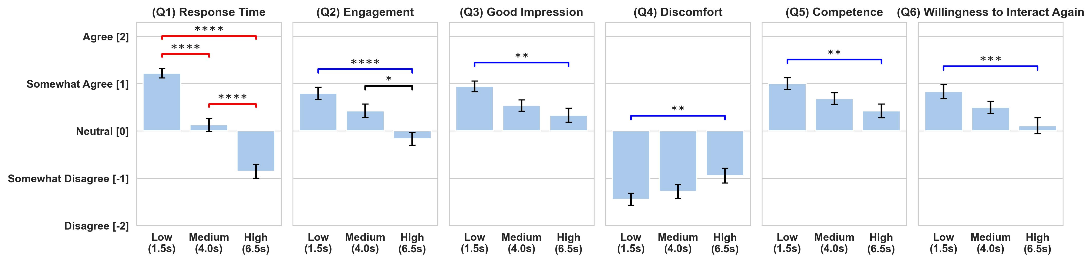
Results: Perceptual effects of IVA response latency
Latency worsened perceived response time

Slide 17
Results: Perceptual effects of IVA response latency
Latency worsened perceived response time
Latency worsened broader perception dimensions

Slide 18
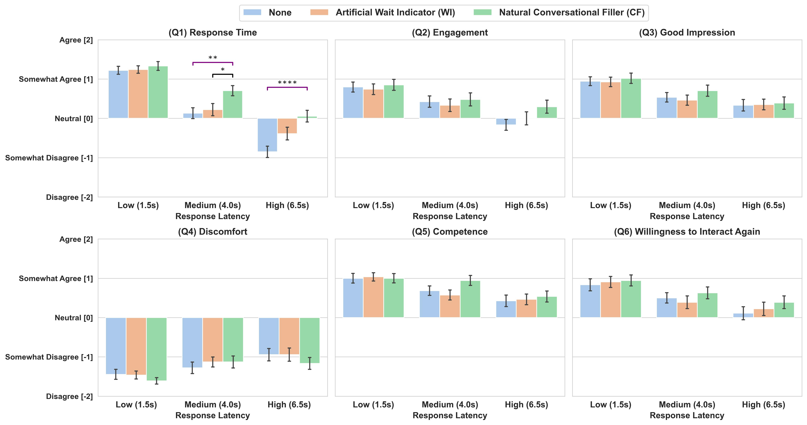
Results: Effects of fillers
Fillers improved perceived response time

Slide 19
Results: Effects of fillers
Fillers improved perceived response time
Fillers did not improve broader perception dimensions

Slide 20
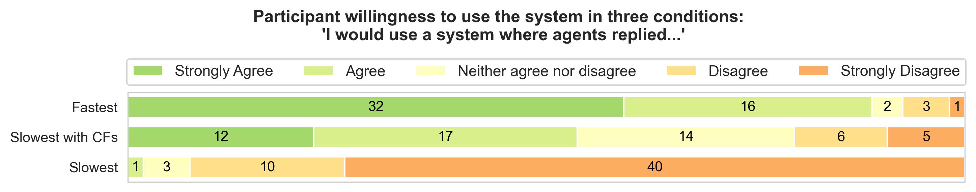
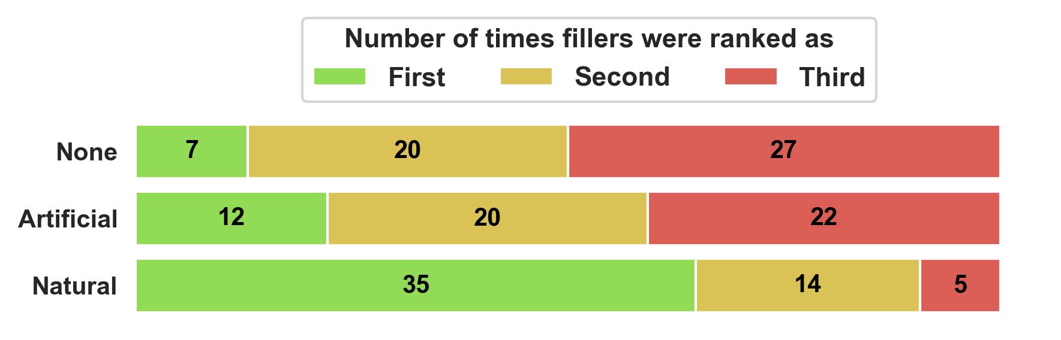
Results: Future use intent and filler preferences
Lower future use intent under high latency
Most participants preferred Natural fillers

Slide 21
Recommendations for future studies with IVAs
Minimize IVA response latency
Aside from participant frustration, latency negatively impacts quality of collected data
Allow response filler personalization
Some participants prefer visual over auditory modalities and vice versa
Maintain participant engagement
Consider gamified scenarios

Slide 22
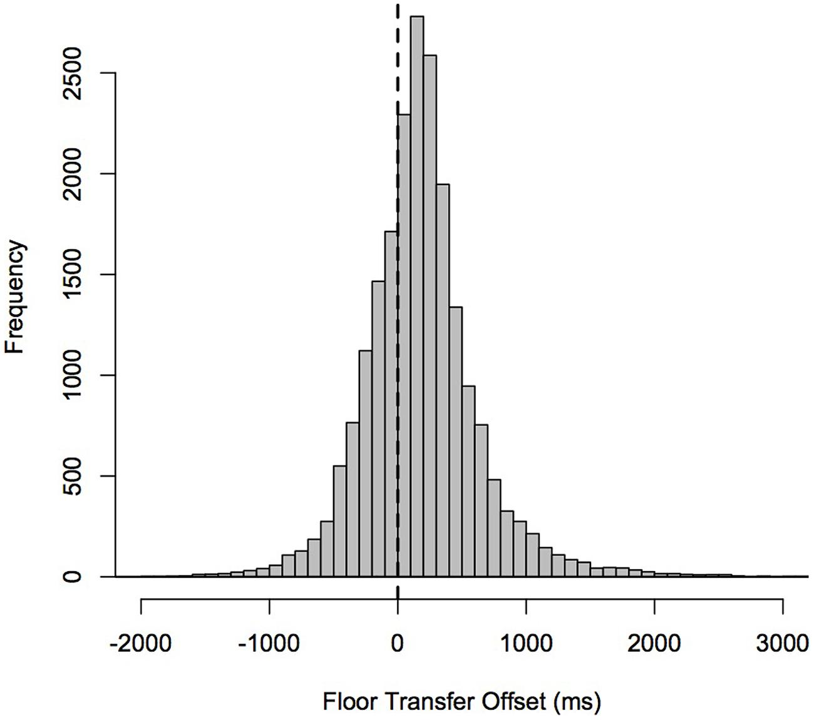
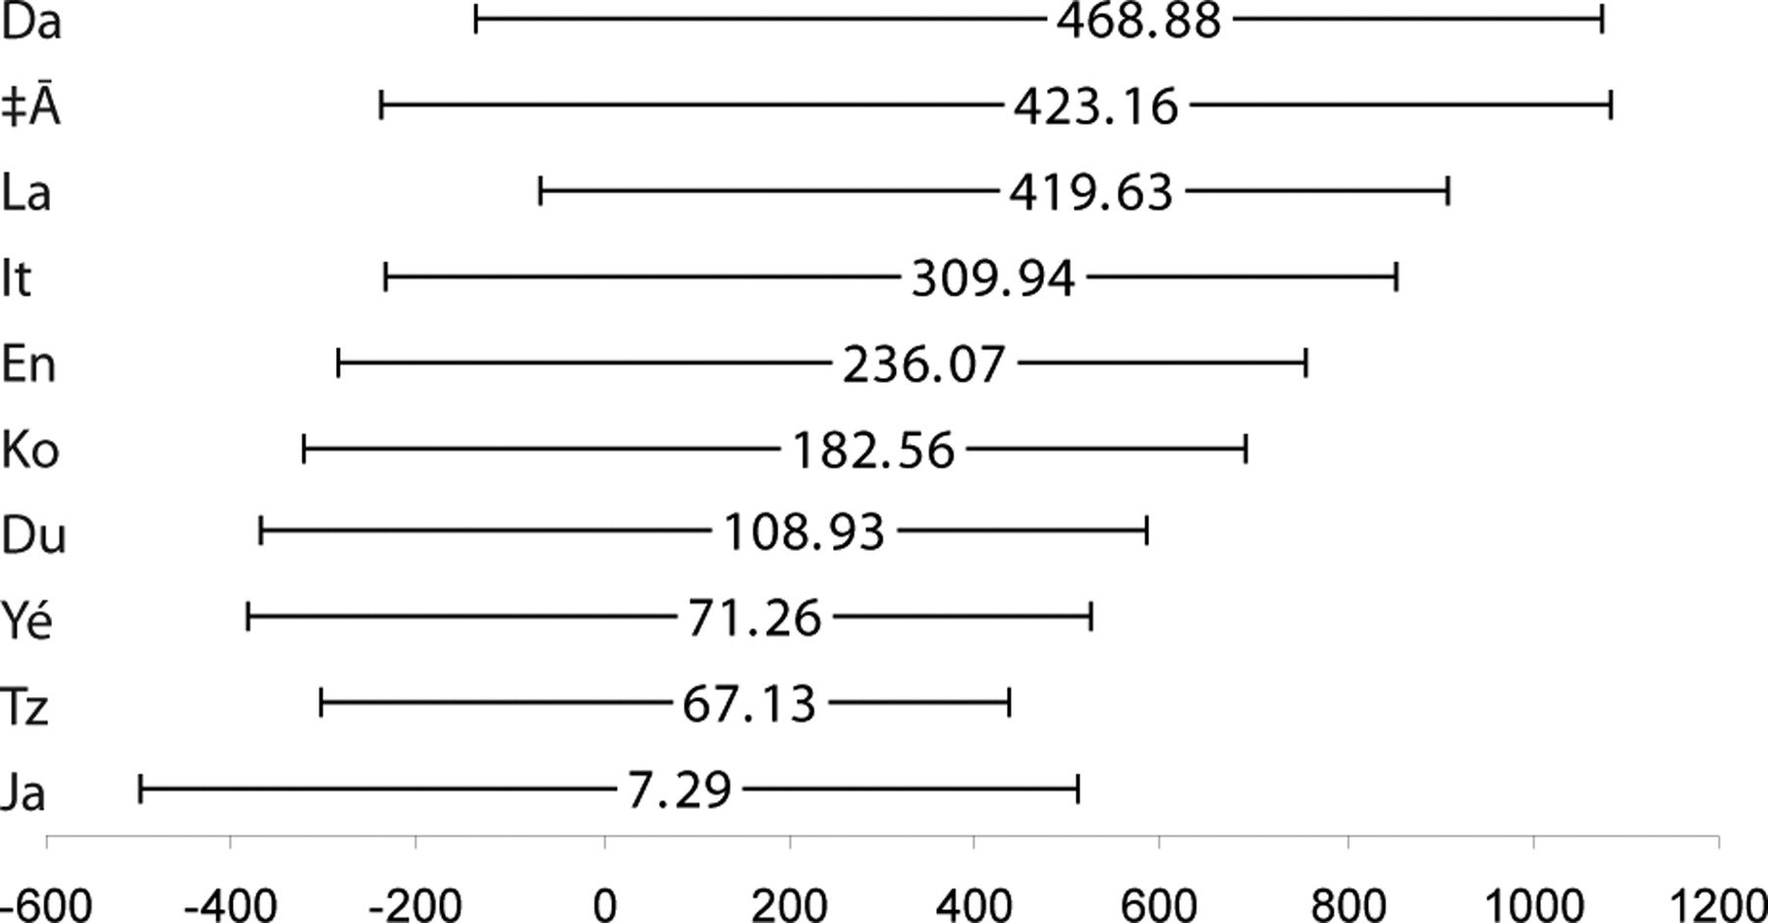
Discussion: Interruptions
Turn-taking “latency” can be negative because humans interrupt one another
Advancements in “real-time” models (GPT-4o, Gemini Native/Live)
Goal: human-likeness vs. usefulness
[Levinson et al., FP ‘15]
[Stivers et al., PNAS ‘09]

Slide 23
Discussion: Contextual latency mitigations
High-stakes scenarios: medical, legal, educational
Useful responses take longer to generate
  Information retrieval (RAG, web search)
  Approaches like CoT (reasoning)
Co-speech gesture generation during ECA response
  [Zhang et al., ICASSP 2025] “XDGesture: An xLSTM-based Diffusion Model for Co-speech Gesture Generation”
  [Hu et al., 2025] “GesPrompt: Leveraging Co-Speech Gestures to Augment LLM-Based Interaction in Virtual Reality”
  [Torshizi et al., 2025] “LLM for Virtual Human Gesture Selection”
  [Yerukola et al., 2025] “Mind the Gesture: Evaluating AI Sensitivity to Culturally Offensive Non-Verbal Gestures”

Slide 24


Mitigating Response Delays in Free-Form Conversations with LLM-powered Intelligent Virtual Agents
Mykola Maslych, Mohammadreza Katebi, Christopher Lee, Yahya Hmaiti, Amirpouya Ghasemaghaei, Christian Pumarada, Janneese Palmer, Esteban Segarra Martinez, Marco Emporio, Warren Snipes, Ryan P. McMahan, Joseph J. LaViola Jr.
ACM CUI '25, Waterloo, ON, Canada
ISUE Lab, UCF eecs.ucf.edu/isuelab
Get software and environments github.com/ISUE/iva-cui
This work was in part supported by NSF Award CNS-2326134, DEVCOM Award W912CG2320004, and the Florida High Tech Corridor Council Industry Matching Research Program.

